Slide 1

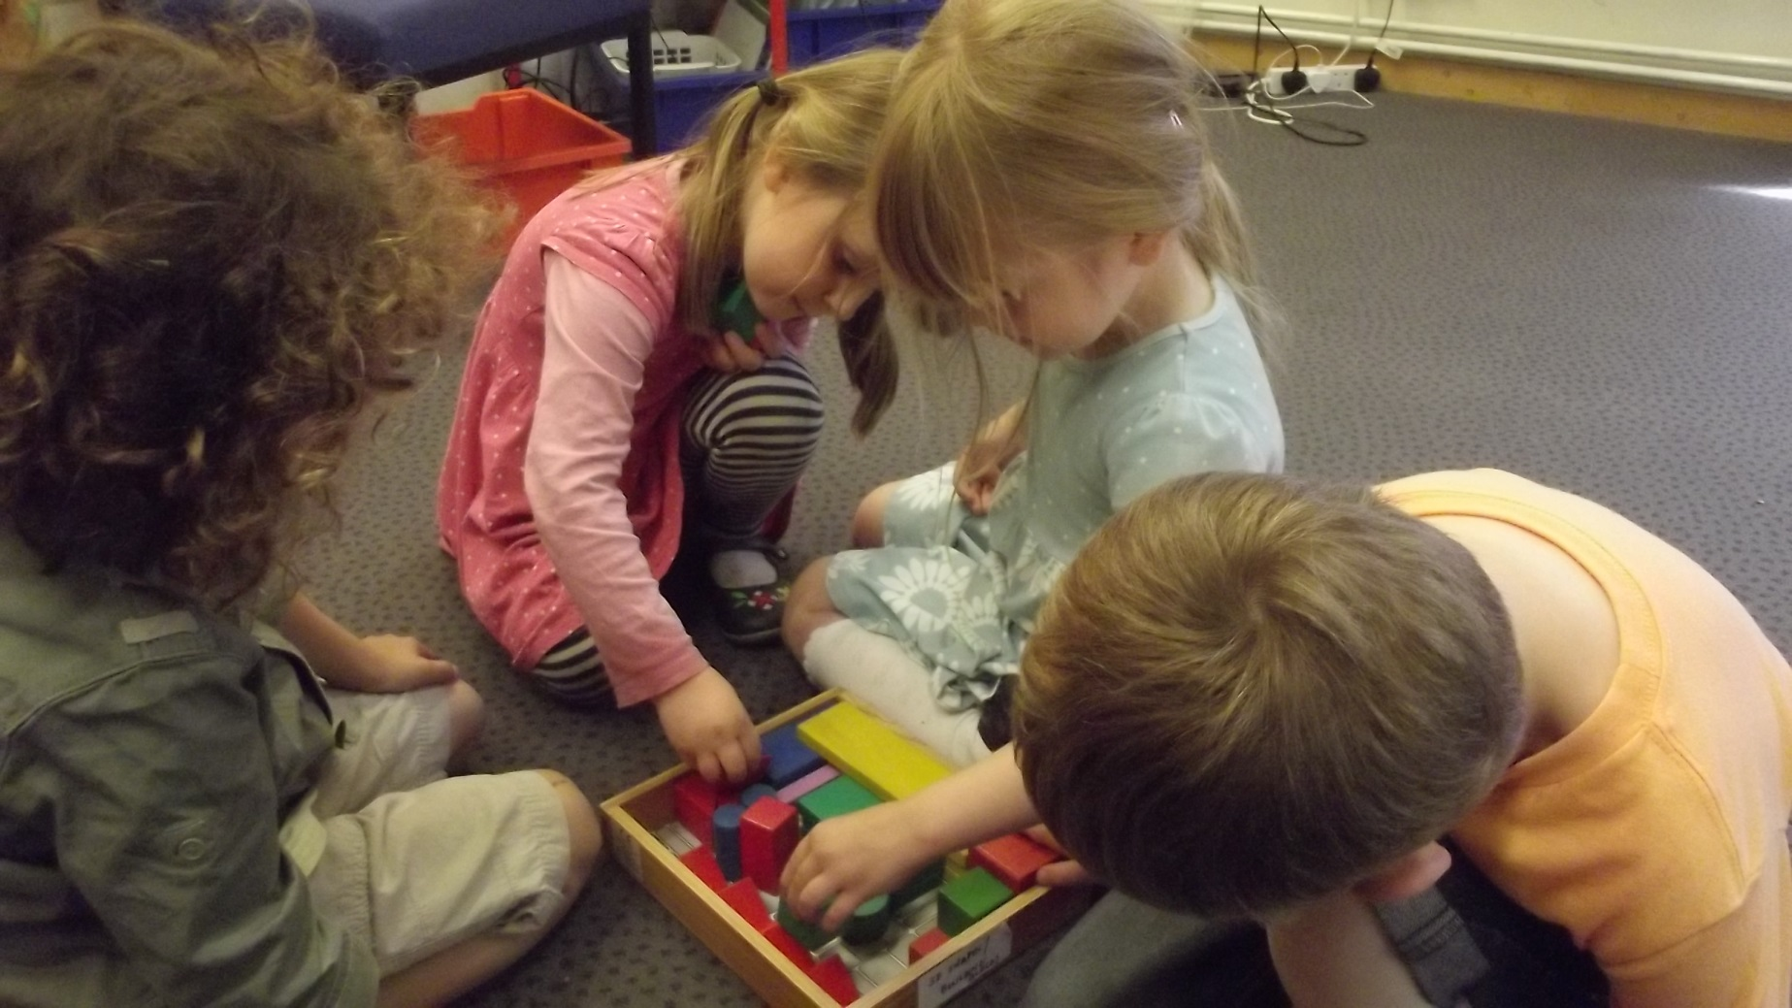
Welcome to the Early Years Workshop

Slide 2
Communication and Language

Slide 3
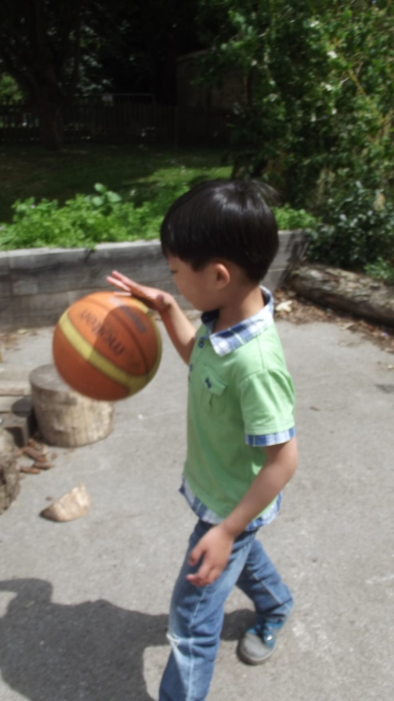
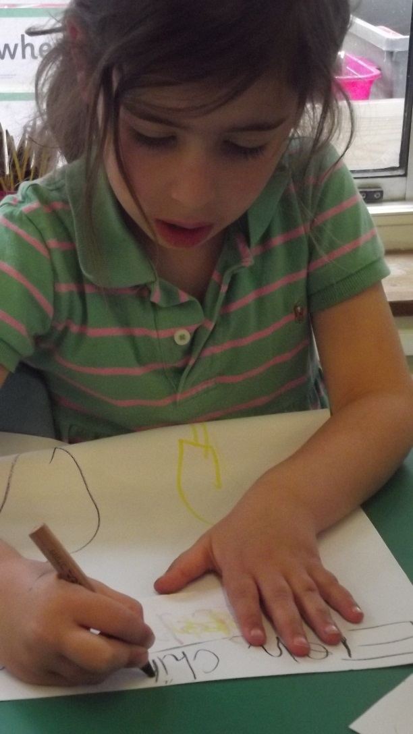
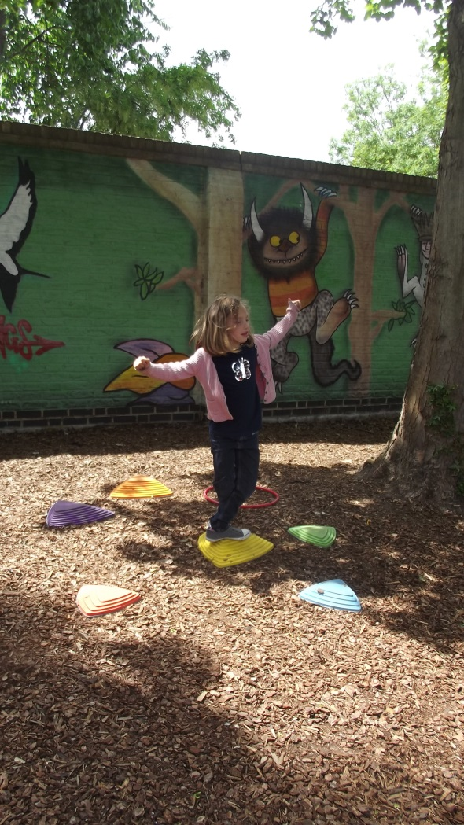
Physical Development

Slide 4
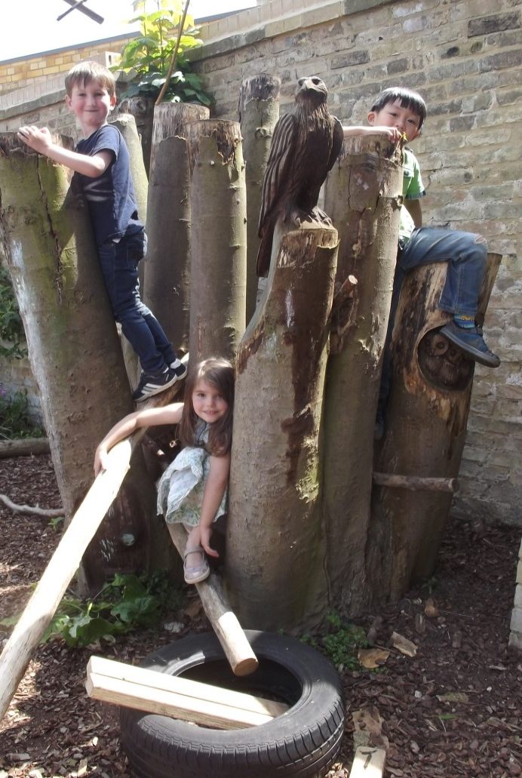

Personal, Social and Emotional Development

Slide 5

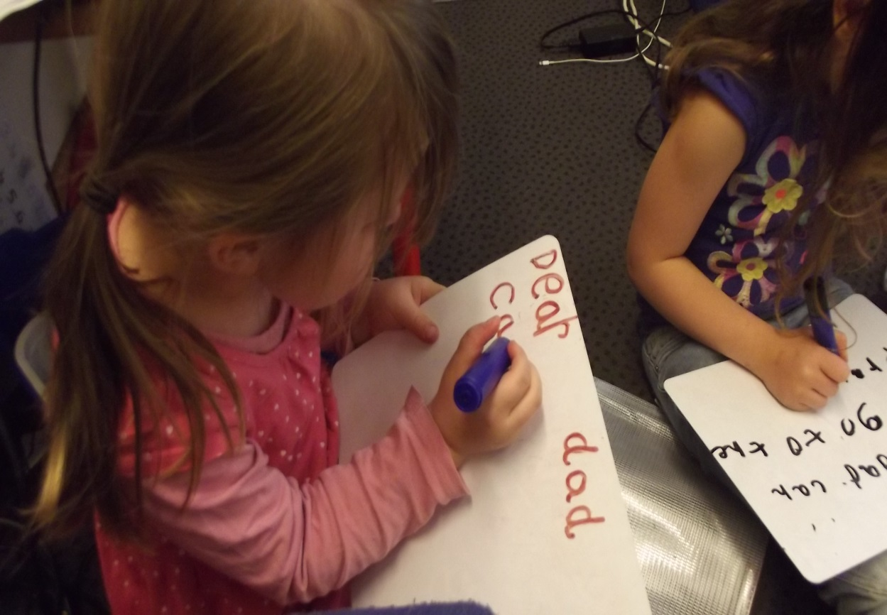
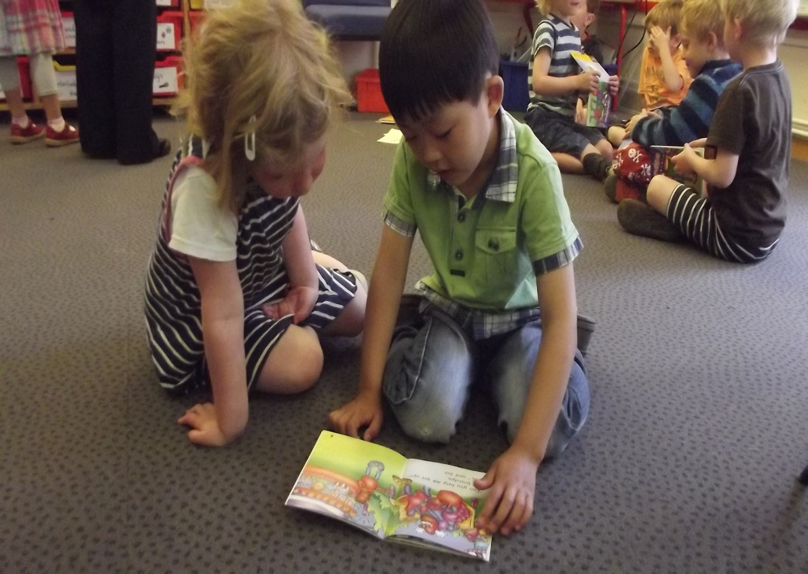
Literacy

Slide 6
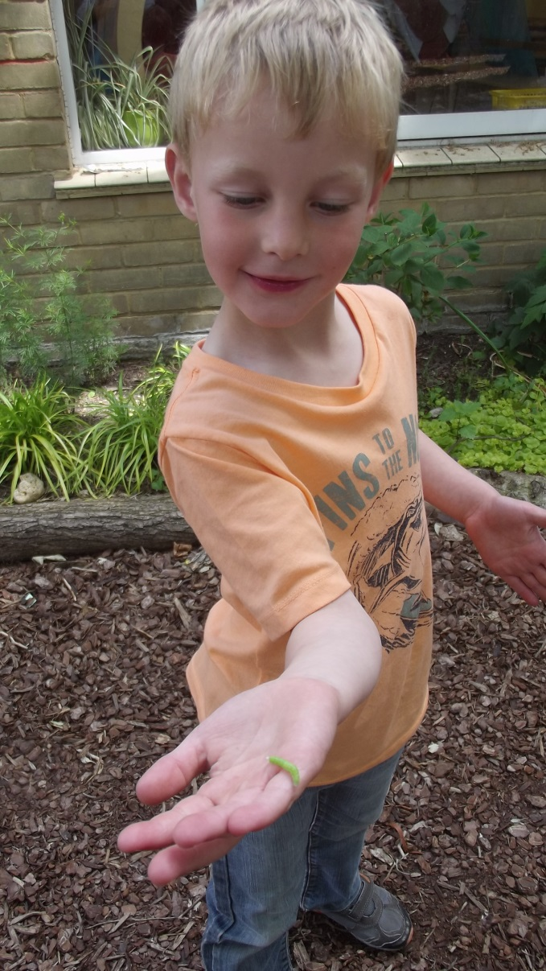
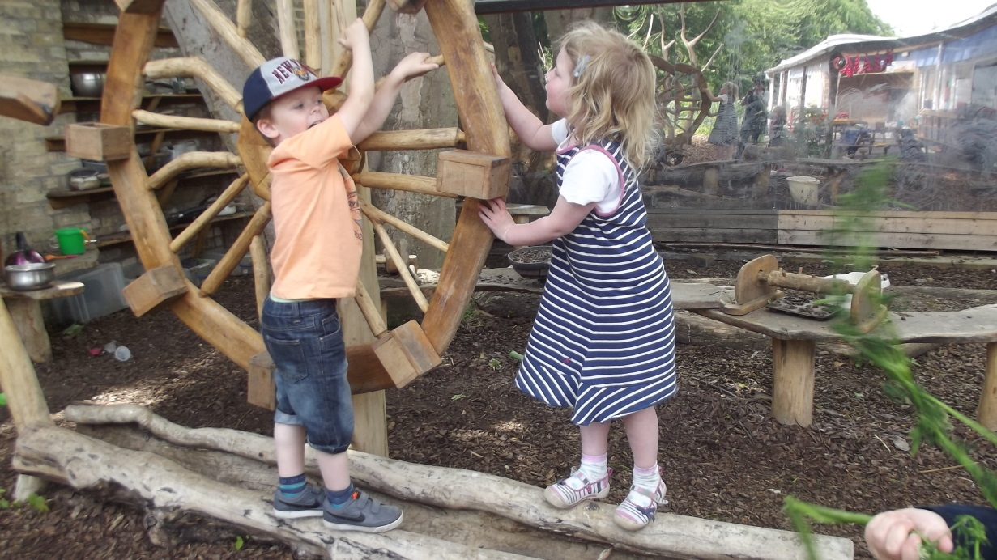
Understanding the World

Slide 7
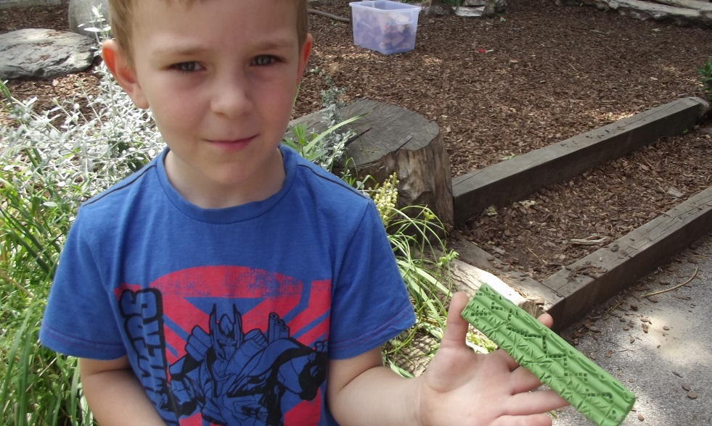
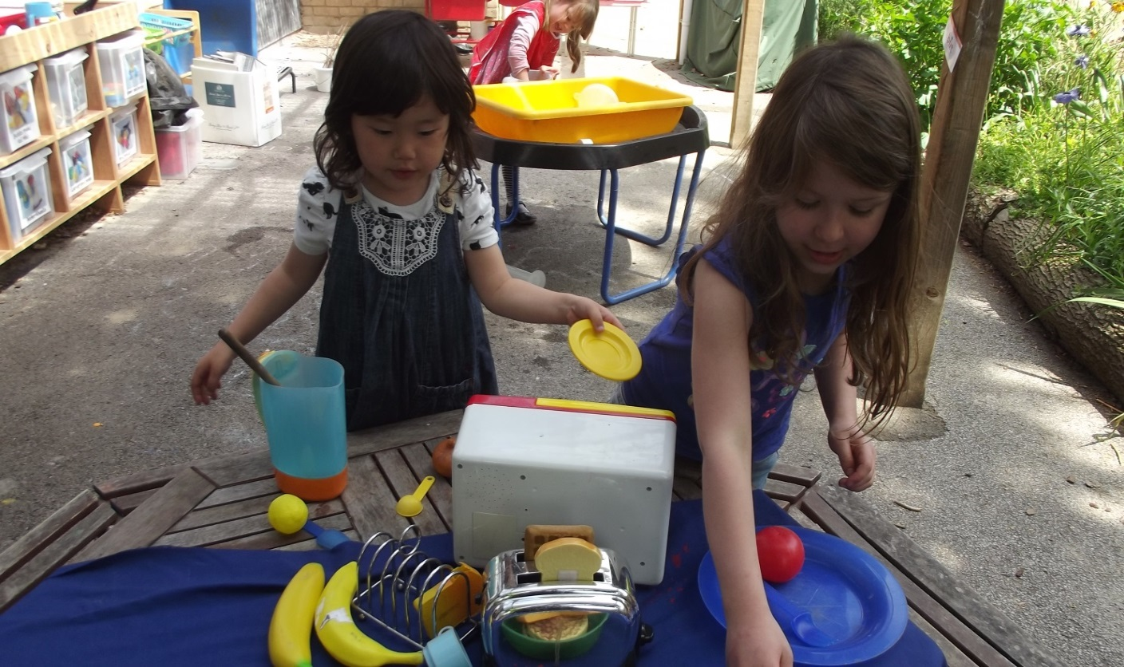
Expressive Arts and Design

Slide 8
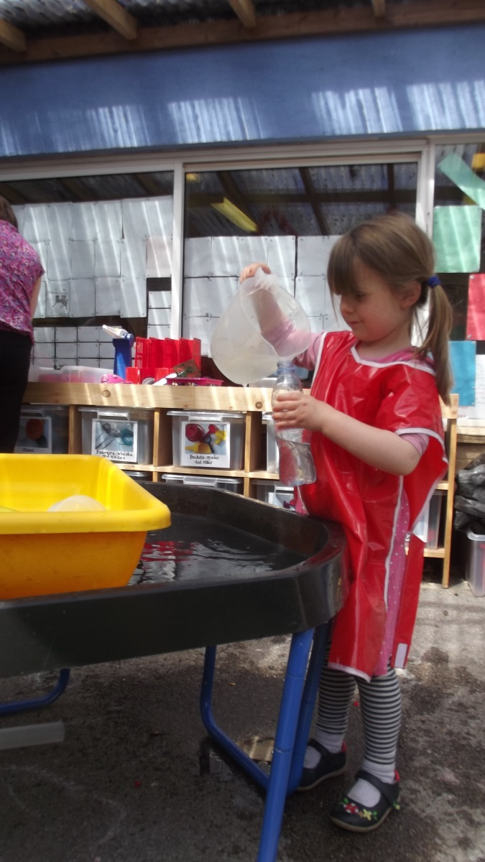
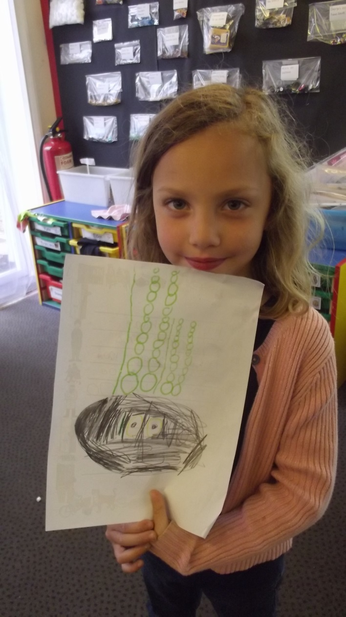
Mathematics

Slide 9
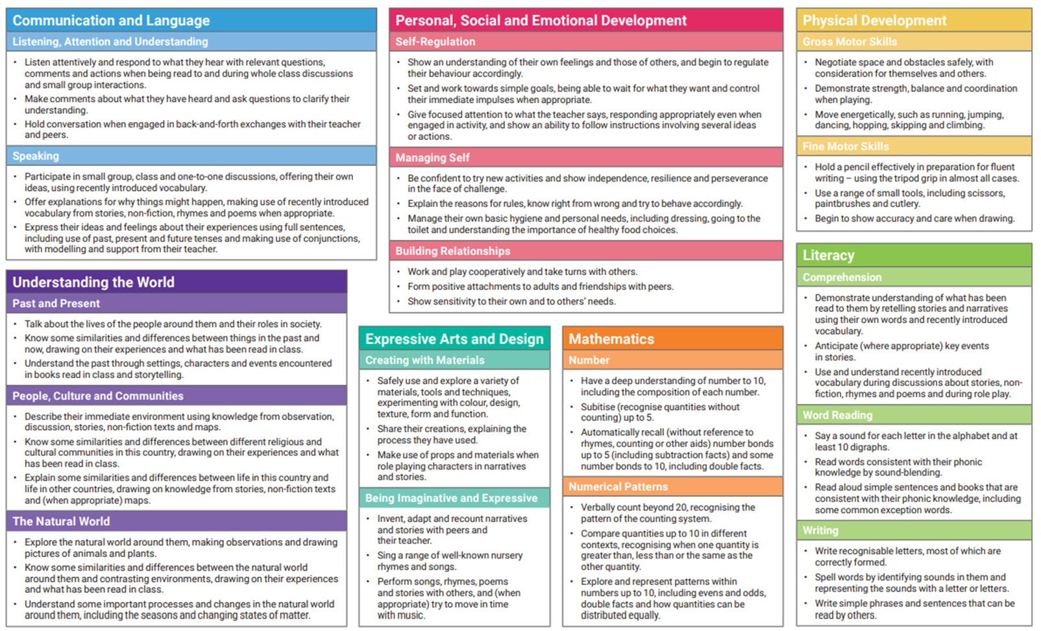
ELG’s

Slide 10
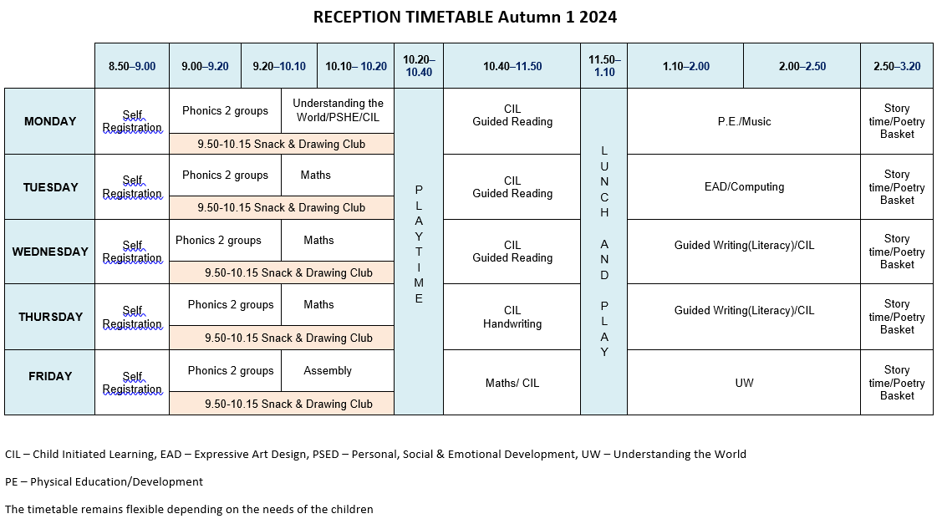
RECEPTION TIMETABLE Autumn 2025

Slide 11

Class Dojo

Slide 12

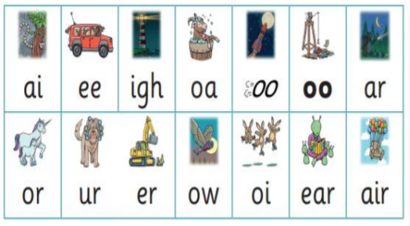
Did you know?
The English language has:-
26 letters
44 sounds
Over 100 different ways to spell those sounds

Slide 13
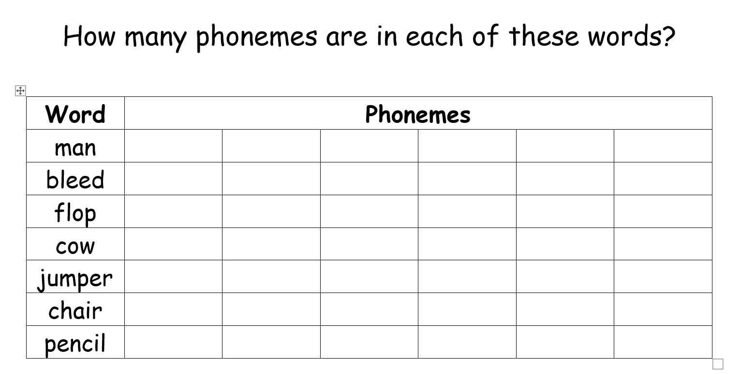

Slide 14
What is Phonics?
Phonics is a way of teaching children how to read and write.
It helps children hear, identify and use different sounds that distinguish one word from another in the English language

Slide 15
How we teach phonics
Daily short sessions
Specific order of teaching
m-u-s-t
Synthetic phonics
Correct pronunciation is vital - Videos on LW
https://www.littlewandlelettersandsounds.org.uk/resources/for-parents/
Repeated practice
Revisit previously
taught sounds at
start of each lesson

Slide 16

Little Wandle
We use a scheme called Little Wandle

Slide 17
Jargon!
You may hear your children say….
phonics (also known as ‘synthetic phonics’) – The teaching of reading by developing awareness of the sounds in words and the corresponding letters used to represent those sounds.
phoneme - Any one of the 44 sounds which make up words in the English language.
grapheme – How a phoneme is written down. There can be more than one way to spell a phoneme. E.g-the phoneme ‘ay’ is spelt differently in each of the words ‘way’, ‘make’, ‘fail’, ‘great’, ‘sleigh’ and ‘lady’.
blending – Putting together the sounds in a word in order to read it, e.g.
‘f – r – o – g, frog’
segmenting – Breaking a word into sounds in order to spell them,
e.g. ‘frog, f – r – o – g’
Digraph- 2 letters making one sound
Trigraph- 3 letters making one sound

Slide 18
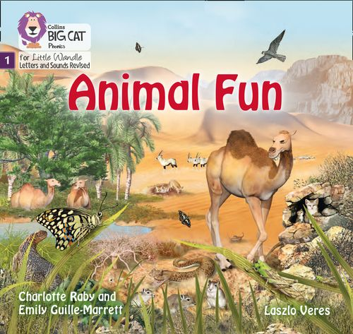
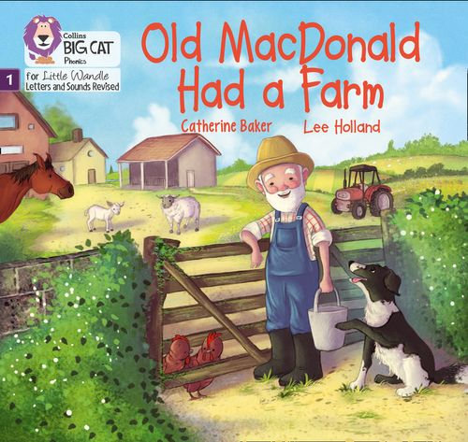
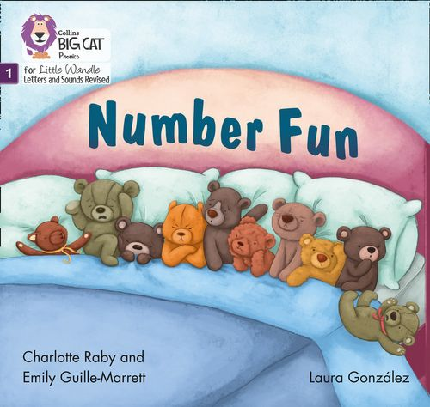
Once children have a secure knowledge of a number of
GPC’s (Grapheme Phoneme Correspondences)
and are confidently blending, they will be ready for
reading books.
Prior to this they may have wordless books which develop
great language skills and teach children the layout of books
and how to handle books

Slide 19

How we teach reading
Reading practice sessions are:
Books are:
Matched to children’s secure phonic knowledge
and word reading
Timetabled 3 times a week
Taught by trained teacher or
teaching assistant
Read three times
Taught in small groups
Book sent home for
the week
Notes:
Quite a big difference to how reading was previously taught

Slide 20
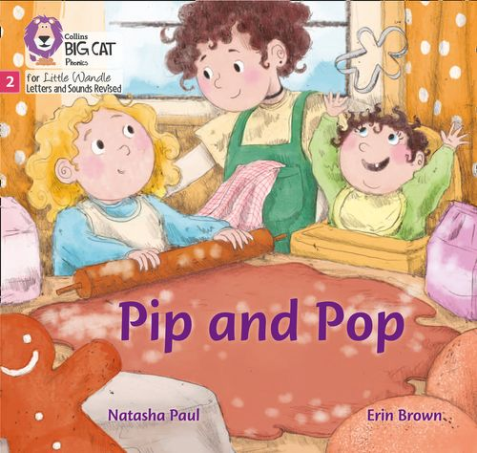

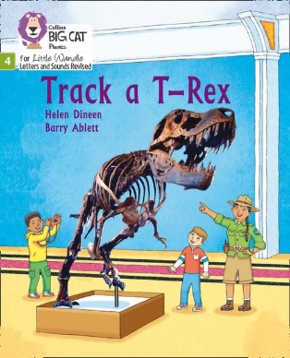
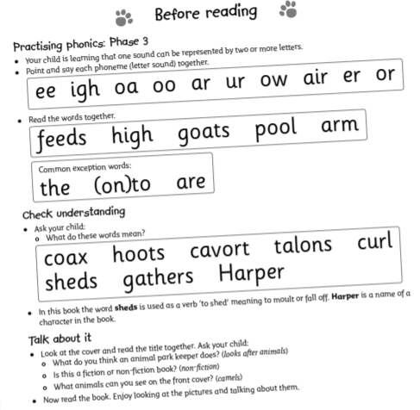
How do we decide which books
children read?
Children are assessed, then LW matches
(along with teacher knowledge) which books
Should be allocated for their secure phonic knowledge.
Children will be allocated their Reading Practice Book
(after reading it 3 times in school)
Share the front cover page before reading – this
cover sounds and words contained in the book.
Celebrate, praise, talk about the book
with you child.
Notes:
Children will not be changing book multiple times a week as previously
Reading groups will be set up so you will be notified of when your book will be sent home/ need to be back in school
Groups will change!

Slide 21
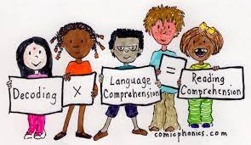
Reading Practice Books carefully matched so children can read
fluently and independently
3 Reads – each one begins with some quick sounds and words practice
Decoding
Prosody
(intonation, expression)
3. Comprehension
When children take their book home to read they should be 95% fluent.
Please do not worry that a book is too easy – your child needs to develop
fluency and confidence in reading. Re-reading a book they have had before
helps develop fluency – this is the goal.
Celebrate their success!!!

Slide 22



2 parts to becoming a confident reader:
At school we put emphasis on both reading for enjoyment and teaching the methods of how to get there (phonics and guided reading)

Slide 23


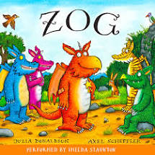


Supporting at home.
Reading for pleasure books
Children will also bring home a ‘reading for pleasure book’ from our class library each week.
To become lifelong readers, it is essential that they read for pleasure
Children may not be able to read this book independently but these books offer a wealth of opportunities for talking about the pictures and enjoying the story or information text.
Enjoy the book together and
foster a love of reading

Slide 24

What else can parents do?
Please look at the Little Wandle videos and guidance for parents
Support children in learning the alphabetic code
Let your child “show off” their reading to you and celebrate and praise all the way!
Share books with your children for pleasure
Check on our ClassDojo site for updates on what has been taught

