Slide 1

Supporting Children with Anxiety About Coming to School
Parent Workshop
Working together: home and school

Slide 2
This session will cover:
What is anxiety?
Why some children feel anxious about school
What anxiety can look like in primary-aged children
Practical strategies to support your child
How school can help
Where to get further support

Slide 3
What is anxiety?
Anxiety is a survival strategy our ancestors developed millions of years ago. It involves the amygdala sensing danger, even when no danger is present. An active amygdala causes stress, and can cause problems when it interferes with daily life.
Children manage is better when they understand the physical responses that they have.
These videos can be helpful to explain:
https://www.youtube.com/watch?v=Cjce9LuboaI - child
https://www.youtube.com/watch?v=rpolpKTWrp4 – teen
https://www.youtube.com/watch?v=jEHwB1PG_-Q - parent

Slide 4
Morning challenges can look like:
Difficulty getting up
Refusing to get dressed
Complaining of stomach aches or headaches
Crying or panic before school
Difficulty separating from parents
What part of the morning is hardest for your child?

Slide 5
School anxiety is when a child experiences strong worry or distress linked to attending school.
It may show as:
School refusal
Physical symptoms (headache, stomach ache)
Meltdowns before school
Clinginess at drop-off
Extreme tiredness after school
Children often cannot explain exactly what the worry is.

Slide 6
Anxiety is one of the most common emotional difficulties in childhood
Around 1 in 8 children experience significant anxiety
School anxiety can increase after:
  illness
  holidays
  big life changes
  friendship difficulties
Avoiding school can reduce anxiety short-term but often increases it long-term.

Slide 7
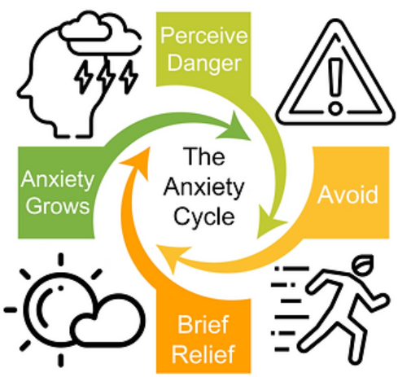
The Anxiety Cycle
Child feels worried about school
They avoid coming in
Anxiety reduces temporarily
Brain learns avoidance works
Next time the anxiety feels even bigger
Facing fears in small steps helps the brain learn that things are safe.

Slide 8
Strategy 1: Validate Feelings
Children need to feel understood, but still supported to attend.
Instead of:
❌ “There’s nothing to worry about.”
Try:
✔ “I can see this feels really hard.”
✔ “We will help you through it.”
✔ “You are brave and we can do this together.”

Slide 9
Strategy 2: Predictable Routines
Routines help children feel safe.
Helpful ideas:
Consistent bedtime
Prepare school bag the night before
Visual morning routine chart
Same goodbye routine each day
Keep goodbyes calm and brief.
Long goodbyes can increase anxiety.

Slide 10
Praise Bravery
Focus on effort rather than fear.
Examples:
“You were really brave coming through the gate.”
“I’m proud of you for trying.”
“You did something hard today.”
Ideas:
bravery charts
small rewards for effort
celebrating progress

Slide 11
Support at School
Emotional support
trusted adult check-in
safe space when overwhelmed
Practical support
quiet entry
flexible morning routine
reduced workload temporarily
Communication
regular updates
consistent plan between home and school

Slide 12
When to Seek Extra Help
Sometimes additional support may be helpful.
This might include:
class teacher
SENCo/Mental Health Lead – me!
GP
child mental health services
Early support can make a big difference.

Slide 13
Key Messages
Remember:
✔ School anxiety is common
✔ Avoidance can make anxiety stronger
✔ Small steps build confidence
✔ Consistent routines help
✔ Home and school working together is powerful

Slide 14
Questions
Questions or reflections?

