Slide 1
Relationships and Sex Education (RSE) at Newnham Croft
8.5.2026
Information for Parents
Based on Cambridgeshire PSHE Service Personal Development Programme

Slide 2
Purpose of This Session
• What is RSE?
• Why it is taught in primary schools?
• Statutory guidance schools follow
• What do children learn in each year group?
• How can you be involved?

Slide 3
Children are increasingly exposed to harmful content online, including misogynistic attitudes and unhealthy views about relationships.
The new guidance supports these challenges and help children to develop positive attitudes.
The new focus is on helping all children identify positive role models and challenge harmful ideas they might encounter online and in real life.

Slide 4
Statutory Guidance
- updated for Sept 2026
• Relationships Education is statutory in primary schools
• Health Education is statutory
• Sex education beyond science is not compulsory
• Schools follow Department for Education guidance

Slide 5
What is RSE?
• Building healthy friendships
• Respect and kindness
• Personal safety and boundaries
• Understanding emotions
• Learning about growing and changing

Slide 6
Why is RSE Important?
• Supports children’s wellbeing
• Helps children stay safe
• Builds respect and empathy
• Prepares children for growing up
• Encourages healthy relationships

Slide 7
What Must Be Taught
• Families and caring relationships
• Respectful relationships
• Online relationships
• Being safe
• Physical and mental wellbeing
• Puberty education before secondary school

Slide 8
Parents’ Rights
• View the school RSE policy and curriculum
• Ask questions about teaching
• Discuss concerns with the school
• Request withdrawal from non‑statutory sex education

Slide 9
How RSE is Taught
• Through PSHE lessons
• Age‑appropriate and progressive
• Discussion and circle time
• Stories and scenarios
• Opportunities for questions
• Taught as whole class, but opportunities for separate question/exploring resources for girls/boys when learning about puberty

Slide 10
Progression Through Primary School
Children revisit topics each year with increasing depth.
Focus develops from:
• Friendship
• Respect
• Managing relationships
• Understanding puberty

Slide 11
Reception (EYFS)
• Recognising feelings
• Making friends
• Sharing and kindness
• Understanding personal space
• Asking trusted adults for help
• Health and self-care (including keeping healthy and safe and managing basic hygiene needs)
Reception usually teach as and when it is appropriate. They often use the NSPCC PANTS as a resource.

Slide 12
Year 1
• Friendship and kindness
• Family relationships
• Naming body parts
• Recognising trusted adults
• Rules and fairness

Slide 13
Year 2
• What makes a good friend
• Respecting differences
• Personal boundaries
• Keeping safe
• Understanding privacy

Slide 14
Year 3
• Managing emotions
• Resolving friendship problems
• Respect and empathy
• Personal safety
• Introduction to body changes

Slide 15
Year 4
• Healthy friendships
• Bullying and how to respond
• Respecting differences
• Self‑esteem
• Growing and changing – including puberty

Slide 16
Year 5
• Puberty and body changes
• Personal hygiene
• Emotional changes
• Respectful relationships
• Online safety

Slide 17
Year 6
• Puberty and reproduction
• How babies develop
• Healthy relationships
• Peer pressure
• Preparing for secondary school

Slide 18
Vocabulary
‘Private Parts’ would be introduced in Reception, and taught along with the scientific or ‘Dr’ names
Vagina, Penis and testicles are used
Later on, the word vulva is used too
From Year 4/5 scientific language for the internal reproductive organs are used too
Children are often given a naming activity, where they consider different words given, but the scientific language is always given by the teacher.

Slide 19
Working in Partnership with Parents
• Schools and families work together
• Open communication is encouraged
• Curriculum information is shared
• Questions are always welcome

Slide 20
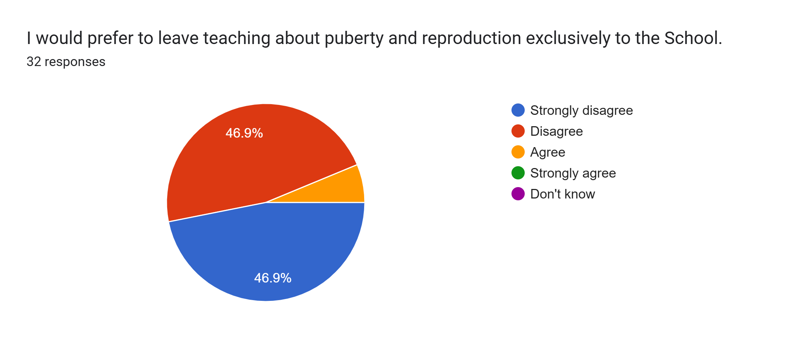
Parent Questionnaire

Slide 21
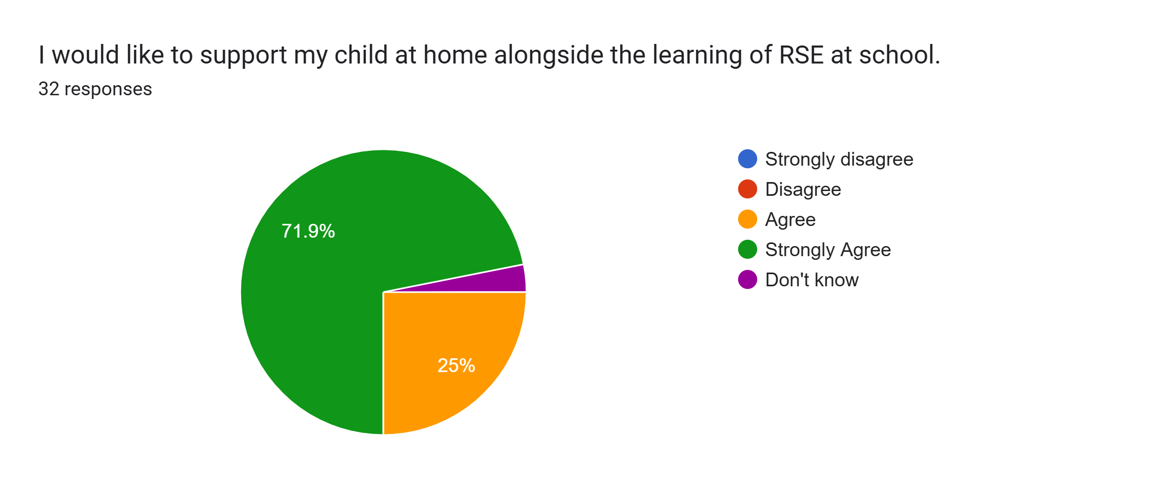
Parent Questionnaire

Slide 22
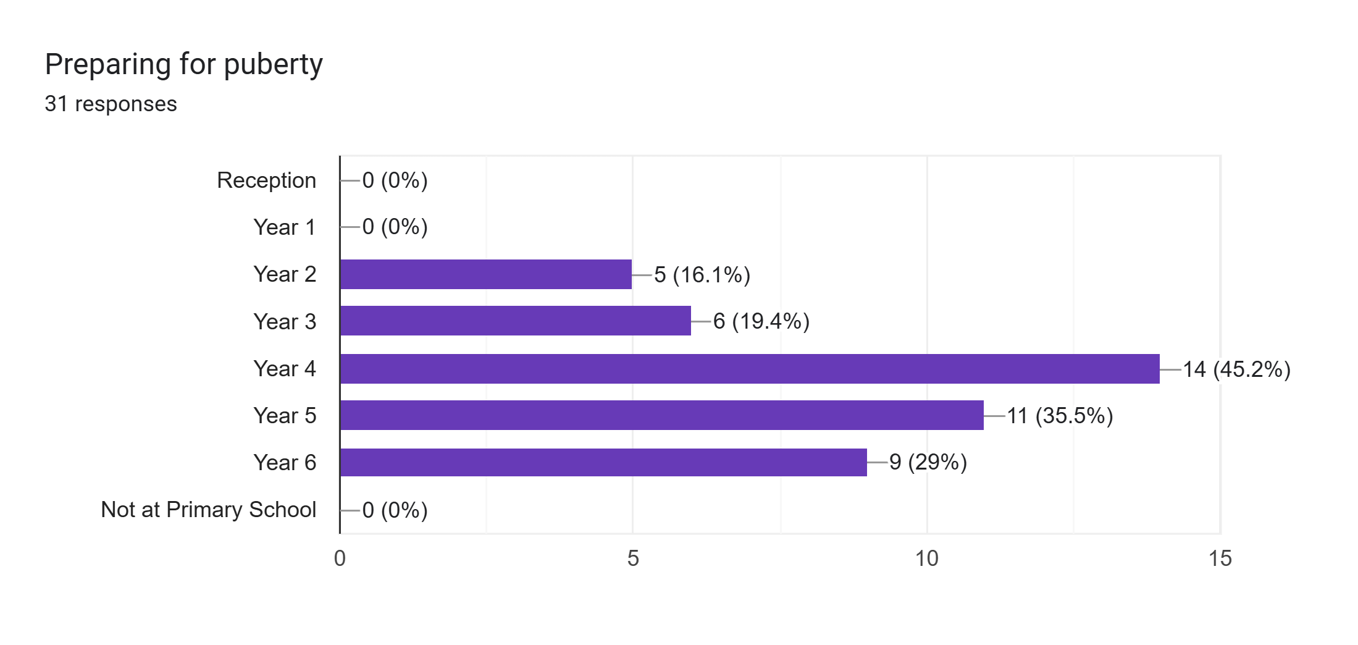
Parent Questionnaire
In which year group should we introduce..

Slide 23
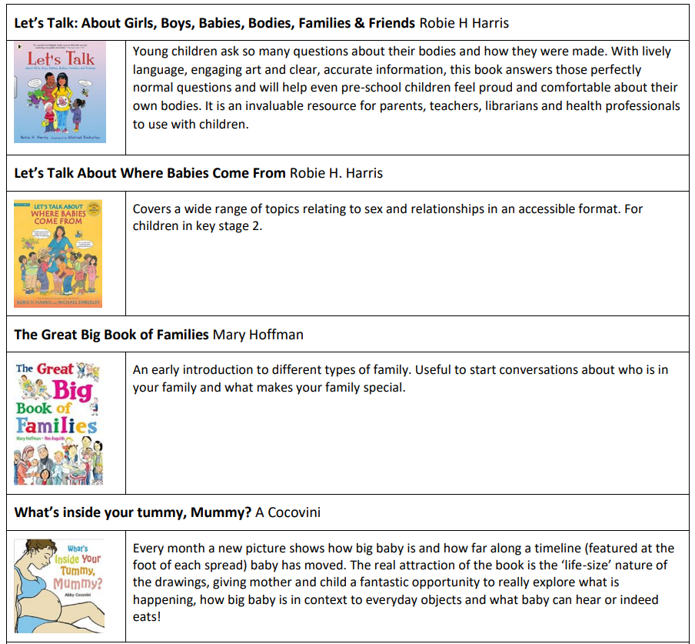
Books

Slide 24
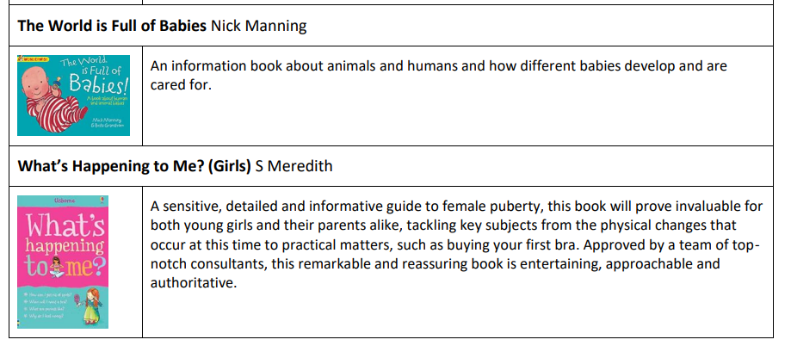

Slide 25
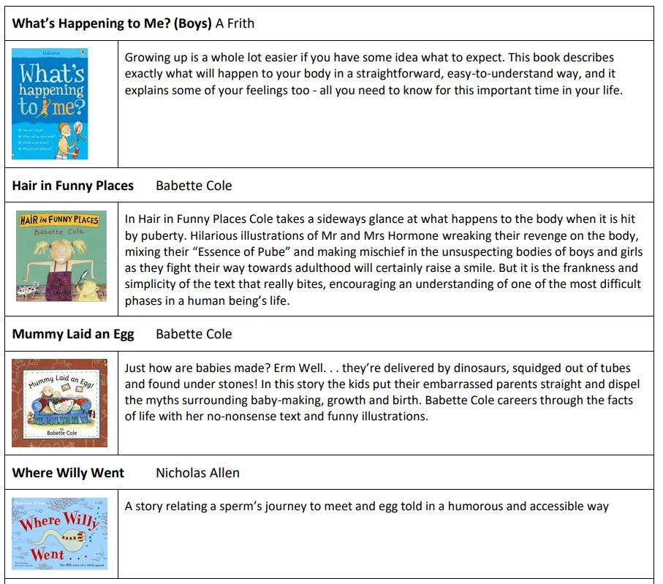

Slide 26
Questions
Thank you for attending.
Any questions?

