Slide 1
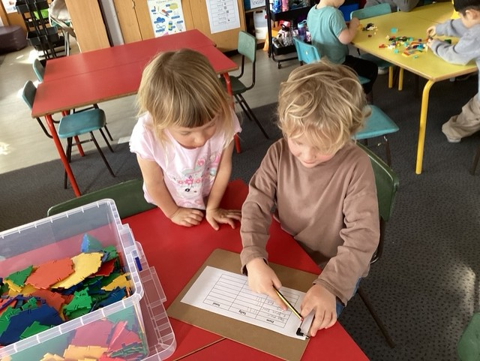
Welcome to
Newnham Croft Primary School

Slide 2
Useful Information
1. What your child will need for school
2. What does a day at school in Reception look like?
3. Transition dates
4. School Website
5. ‘School Readiness’
6. What next?

Slide 3



What your child will need for school
* All items should be labelled with your child's name

Slide 4
A day at school
Drop-off
What we do in a typical day
Snack
Lunch
Pick-up
How can you keep informed about what your child is doing?
  Newsletter
  Parent/Teacher consultations
  Open school sessions
  Chat!

Slide 5
Induction Dates

Slide 6
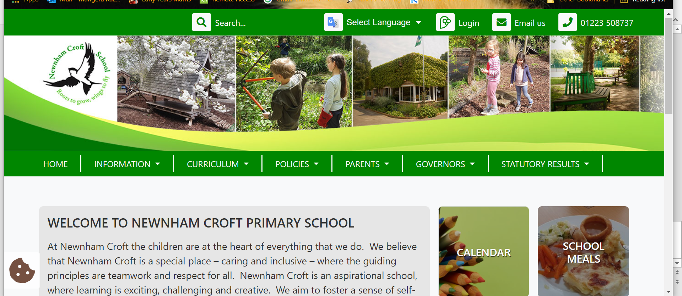
www.newnhamcroft.cambs.sch.uk

Slide 7

What does it mean to be ‘School Ready’?

Slide 8

What next?
Come and visit the classroom with your child on Friday 27th July 1.45pm -2.45 pm

